Slide 1
Transaction & Remoting & Networking

Slide 2
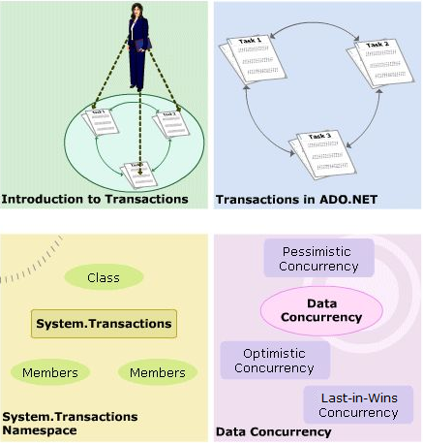
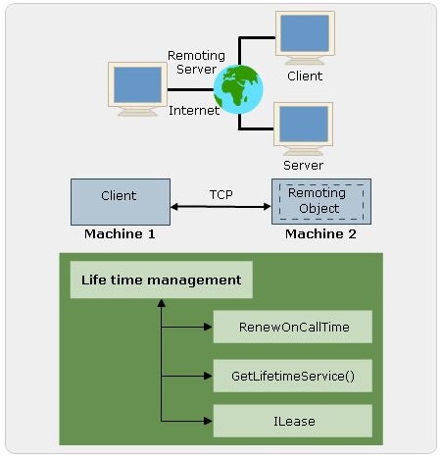
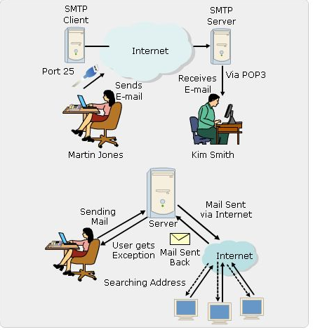
Objectives
Transactions
.NET Remoting
Introduction to SMTP
E-mail with .NET
Networking and Internet

Slide 3
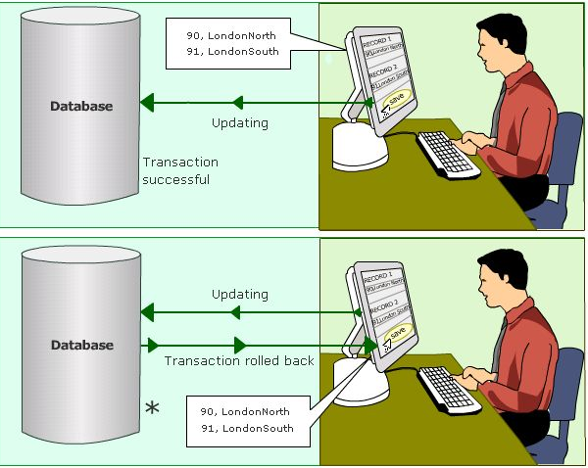
Transaction
Transaction is a process that ties a group of tasks together.
It either excutes as a whole, or rolls back till a paticular state.
Ite assures the unity and consistency of each process in an operation

Slide 4
Use of Transactions
Transaction are used in scenarios where many operations are to be executed as a unit . Transactions are mainly used in following situations :
When multiple rows are modified as single unit
When changes to single table need to reflect in multiple tables
When multiple database required concurrent modification of data
When records are changed in databases present in different servers
Transactions can be categorized as :
Internal Transactions
External Transactions

Slide 5
ACID Properties
Atomicity : Ensures that a transaction either perform all the operation or does do anything.
Consistency: Ensures that the data is consistent after the transaction closed.
Isolation: Ensures that modifications made by a concurrent transaction are isolated from other concurrent transaction modification
Durability: Ensures that all the changes made in the system are pernament even after a system failure

Slide 6
Isolation Levels
The isolation level of a transaction can be configured to minimize lock contention
A properly set isolation level of a transaction can avoid deadlocking situations.
ReadUncomitted: Transaction sees the uncommitted changes made to the data by other transaction
ReadCommitted: The default isolation level, a transaction reads data only from a committed table.
RepeatableRead: The transaction applies a shared lock on all the data that it queries.
Serializable:Locks are applied on mutiple tables that being used

Slide 7
Transaction Mechanisms
The mechanisms that a developer can use to control a transaction are as follows:
Database Transaction: These transaction use store procedures to start and commit the transaction
ADO Transaction: These transaction perform the transaction operation within the current connection and execute multiple commands againts the database.
ASP.NET Transaction: These transactions execute at the web-application page level . Using a page level attribute of Transaction = “Required”
Enterprise Services Transactions: Manage transaction by using the methods listed on COM+

Slide 8
Transactions in ADO.NET
Transactions in ADO.NET need an open connection instance and a transaction instance
ADO.NET calls the BeginTransaction() method of the connection class to commence the transaction.
All the required SQL statements within a transaction are executed to call the Commit() method for the given object.
The Transaction rolls back using the Rollback() method when an error occurs during the process

Slide 9
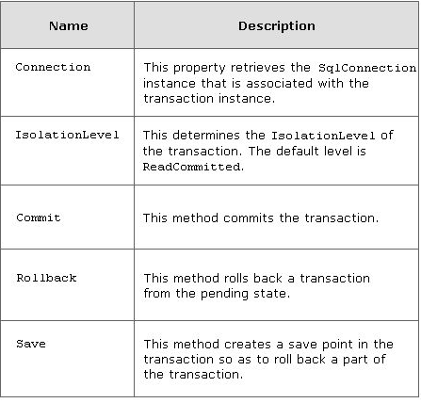
Transactions in ADO.NET
SQL Transaction class represents a Transact-SQL transaction to be made in a SQL Server database.
It belong to the System.Data.SqlClient namespace.

Slide 10
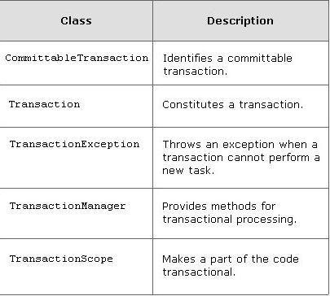
Transactions in ADO.NET
System.Transactions namespace makes the concept of transactional programming simple and effcient.

Slide 11
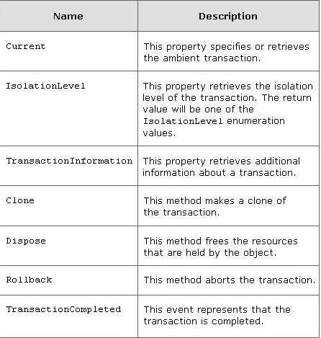
Transactions in ADO.NET
The Transaction class indicates a transaction.
The System.Transactions namespace uses Transaction class to provide an explicit programming model.

Slide 12
Concurrency Control
Situations may arise when the data is being modified by multiple users simultaneously . In order to avoid a single user’s modification from adversely affecting other’s modification, a process known as Concurrency control is developed
The three common ways to manage concurrency in a database are :
Pessimistic Concurrency
Optimistic Concurrency
“Last-in-Wins”: is similar to Optimistic concurrency. The only difference being that the updates are not compared against the original records.

Slide 13
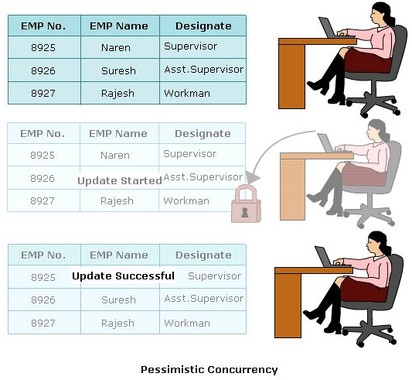
Concurrency Control
Pessimistic Concurrency : a record is locked at the time the user begins the edit process on the record.

Slide 14
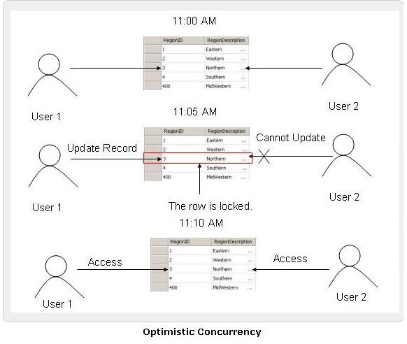
Concurrency Control
Optimistic Concurrency: a row is only locked during the update to the database

Slide 15
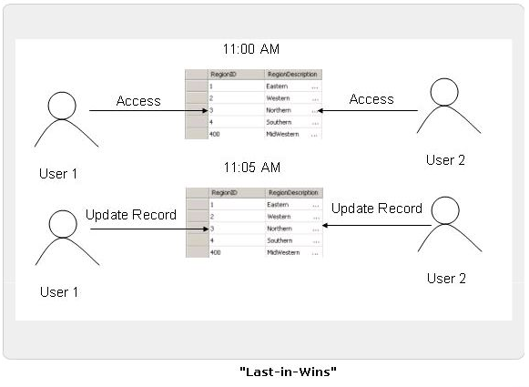
Concurrency Control
“Last-in-Wins”: is similar to Optimistic concurrency. The only difference being that the updates are not compared against the original records

Slide 16
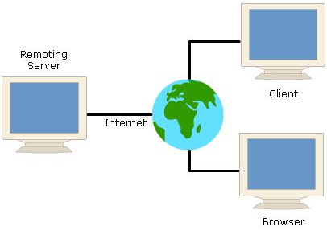
.NET Remoting
Modern day application development revolves around the distributed computing approach.
Distributing computing approach involves dividing a large problem into many small parts which are solved by a number of computers .
.NET Remoting is a mechanism that provides developers with a framework for objects to interact with one another across application domains whether on same physical domain or over a network

Slide 17
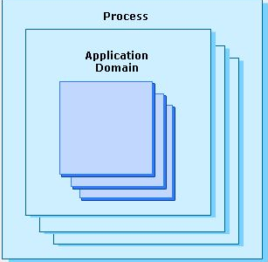
.NET Remoting
An Application Domain is a logical and physical boundary that ensures one application cannot influence another application
A .NET application is comprised of one or more assemblies that run inside an application domain .
A application domain is a .NET equivalent of a process. A process is generally a running application

Slide 18
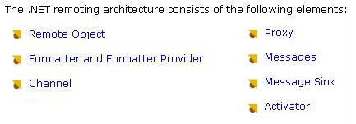
.NET Remoting Architecture
Basically in remoting , a remoting server provides access to a remoting object which is accessed and used by client
The remoting client and server may be run in different processes on the same machine, or on two different mechines altogether as well these computers an access each other through a network
.NET Remoting use communication protocols such : HTTP and TCP( Tranfer Control Protocol/Internet Protocol)

Slide 19
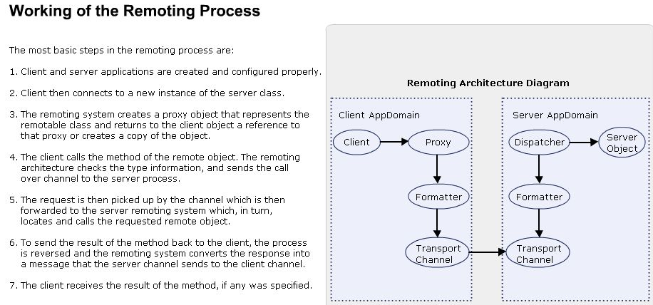
Woking of the Remoting Process

Slide 20
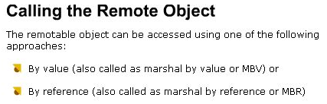
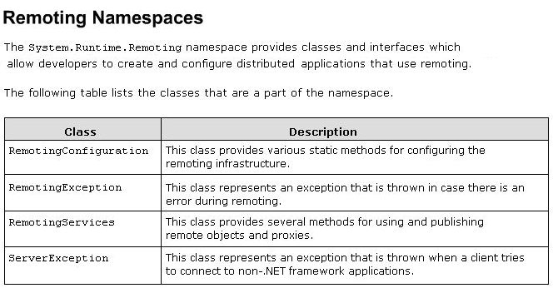
.NET Remoting Achitecture

Slide 21
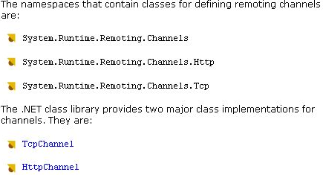
Channels
Channnels are objects whose sole is to tranfer messages from one object to another object
The channels are responsible for transporting a message to a remote object, and ensure that any method return values that are passed from the remote object to the client

Slide 22
Types of Remoting Activation
Remoting activation refers to the various ways a remote object can be instantiated.
The MarshalByValue object is create when it is request by the client and is created as local copy of the object.
The MarshalByReference objects are basically created as proxies of the original object.
Two activation schemes namely :
Server Actived Objects : are created when Client makes the first call to the remote method and a local proxy is created in the client.
Client Actived Objects: An instance of the client activated object is created every time the client instantiates one, either by the use of the “new” keyword or the Activator.CreateInstance() method.

Slide 23
Passing Objects to Remote Methods
Objects that are created remotely are returned by a reference and have to from MarshalByRefObject.
The parameters types of these remote methods need not be confined to the base data types but can also include custom class types defined by the developers
The three ways in which objects can be passed to remote methods are:
Marshal by Reference
Marshal by Value
Non-remoteable

Slide 24
Asynchronous Calls
Asychronously calling a method on a remote object required no changes to the object being remoted to the server. The changes are made to the client code.
The idea is that the thread that makes a call to method returns immediately to the calling program without waiting for the call to be completed, while at the same time the task goes on
Making asychronous calls to a remote method involes declaring a delegate, asynchronously invoking a delegate, and using asynchronous one-way calls

Slide 25
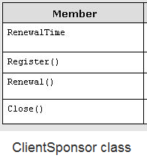
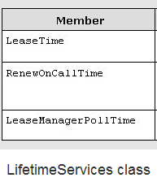
Lifetime Management
“System.Runtime.Remoting.Lifetime” namespace contains classes that are required to manage the lifetime of the remote object. The classes that are a part of this namespace are ClientSponsor and LifetimeServices

Slide 26
SMTP Model
Simple Mail Tranfer Protocol (SMTP) is a protocol is of set rules that resources follow for communication.
SMTP protocol defines the rules, which are followed by SMTP servers to send e-mails reliably
SMTP uses ordered data stream channel to tranfer the data
SMTP is used only to send emails with port 25, to receive emails uses another protocol called POP3( Post Office Protocol version 3) is used.

Slide 27
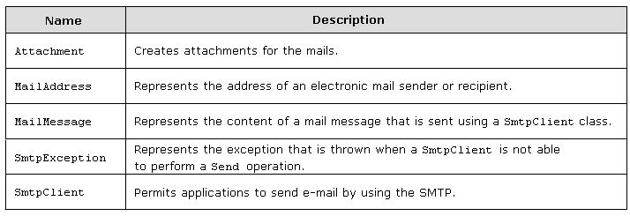
System.Net.Mail
Microsoft .NET Framework enables applications to send e- mails using System.Net.Mail.
This namespace consists of classes that are used to compose e-mail, create attachment, and send the message as an e-mail
It contains classes to send e-mail to a SMPT server for communication

Slide 28
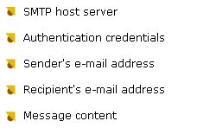
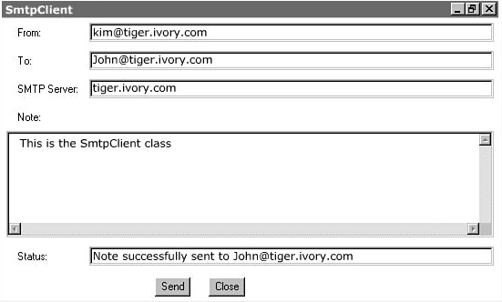
SmtpClient Class
E-mails in SMTP applications are sent across using the SmtpClient class.
The following information must be defined when a SmtpClient is used to send an e-mail message.

Slide 29
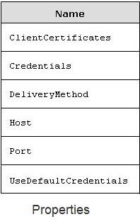
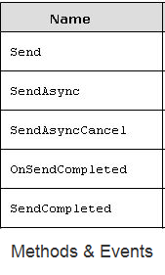
SmtpClient Class
SmtpClient class allows application to send messages by using the Simple Mail Tranfer protocol

Slide 30
Email with .Net
The MailMessage class indicates the e-mail message , it contains properties : From,To.Cc,Bcc,Attachments, Subject, and Body.
The MailAddress class class represents the address of the e-mail sender or receiver,it contains properties : Address, Display, Host and User
The Attachmet class indicates an attachment to an e-mail and used with the MailMessage class , it contains properties: ContentDisposition, ContentStream, ContentType,Name,NameEncoding and TransferEncoding
Exception handling uses classes: SmtpException, SmtpFailedRecipientException, SmtpFailedRecipientsException

Slide 31
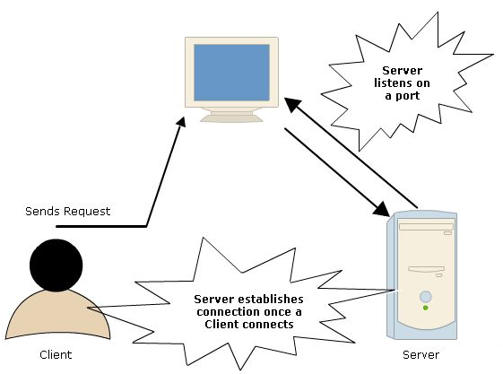
Networking
Connection of various resources is known as networking
Networking allows all the computers to be connected together in a common network and thus sharing of resources becomes less expensive
Two namespaces that are required for networking are :
System.Net
System.Net.Sockets

Slide 32
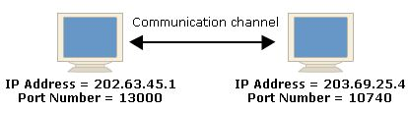
Tranmission Control Protocol
The Tranmission Control Protocol(TCP) contains classes and methods for connecting and sending data between two points.
A point consists of both an IP and port number.
The TcpClient and TcpListener classes create the TCP connections on the internet and contain methods and properties for connecting, sending and receiving stream data over the network.

Slide 33


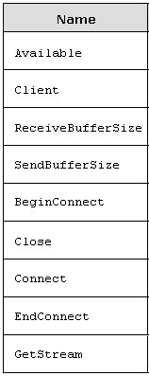
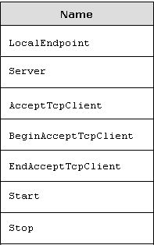
Tranmission Control Protocol

Slide 34
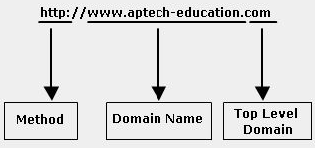
Tranmission Control Protocol
Internet Address
Top Level Domain(TLD)
Domain Name
Host Name
Method/Scheme
Internet Protocol (IP) or Internet addressing protocol allows the user to have an address to aid a scalable data communication system

Slide 35
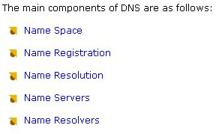
Domain Name System(DNS)
Domain Name System(DNS) is the process , which converts Internet address in mnemonic form into the equivalent number IP address
DNS can also be considered as an database that is present on various computers and has names and IP address of various hosts on the internet.

Slide 36



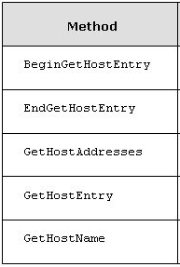
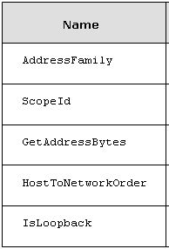
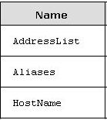
System.Net namespace

Slide 37



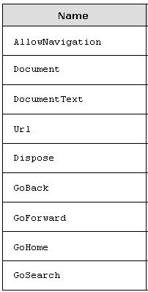
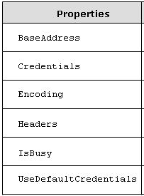
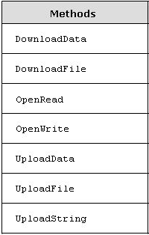
Accessing Internet
WebBrowser control hosts Web page and other browser enabled documents in Windows applications.
WebClient class provides common methods for sending and receiving data from any local, or internet resource described by URI

Slide 38

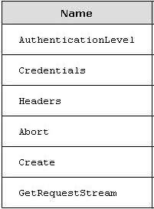
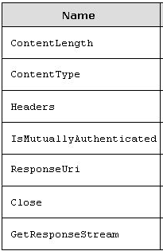
WebRequest & WebResponse Class
The WebRequest is an abtract class that makes a request to URI
WebResponse class is the abstract base class that providers a response from URI . Client applications create WebResponse objects by calling the GetResponse() method on a WebRequest instance.

